Slide 1
The Measurement of Inequality
Rajiv Sethi and the CORE Team

Slide 2
Overview
The meaning of inequality
Visualization using Lorenz Curves
Measurement using the Gini coefficient
Market and disposable income
The Gini Coefficient
Reading: The Economy 5.12 to 5.14 and A World of Differences Sections 1-3

Slide 3

Camden and Cherry Hill
Adjacent municipalities, six miles apart, similar population size

Slide 4
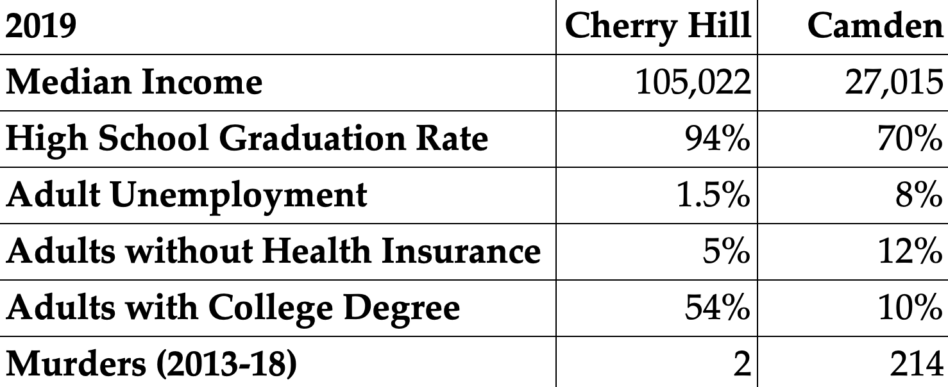
Camden and Cherry Hill

Slide 5
Measuring Inequality
Economic inequality is among the defining issues of our time
Multiple dimensions: income, wealth, opportunity, status, etc.
How do we visualize and measure inequality?
Lorenz curves used for visualization comparison across time and space
Gini coefficients used as a single-number measure

Slide 6
General Principles

Slide 7
Inequality Measures
A useful measure of inequality should allow us to answer questions such as:
Does Australia have more inequality than India?
Was inequality greater in South Africa under apartheid than it is now?
Has inequality in the US risen or fallen over the past few decades?
That is, we need to compare inequality across time and space
Across societies with different population sizes and levels of prosperity

Slide 8
Example
Consider the following income distributions:
X = (24, 76)
Y = (17, 34, 49)
Which is more unequal? Can they even be ranked?

Slide 9
The Transfer Principle
An equalizing and order-preserving transfer lowers inequality
Example:
X = (17, 34, 49)
Y = (18, 37, 45)
Which society is more unequal?

Slide 10
Income Neutrality
A change in all incomes by the same multiple leaves inequality unchanged
Example:
X = (17, 34, 49)
Y = (35, 77, 88)
Which society is more unequal?

Slide 11
Population Neutrality
Suppose two or more identical societies are combined
Inequality in the composite equals inequality in the components
Example:
X = (17, 34, 49)
Y = (17, 18, 34, 37, 45, 49)
Which society is more unequal?

Slide 12
Earlier Example
Consider the following income distributions:
X = (24, 76)
Y = (17, 34, 49)
Which is more unequal? Can they even be ranked?
Solution: https://interactive-economics.shinyapps.io/MeasuringInequality/

Slide 13
Lorenz Curves

Slide 14
Lorenz Curves
Suppose population size is n (individuals, families, countries)
Suppose total income is X
Sort population in order of increasing income
At each income level, calculate cumulative share of population below
And calculate cumulative share of income held by this group
Example: 100 farmers, 90 own no land, rest own 100 acres each
90% of population has cumulative share 0, 100% has cumulative share 100
How do we visualize inequality in landholding?
What if each farmer had 10 acres each (perfect equality)?

Slide 15
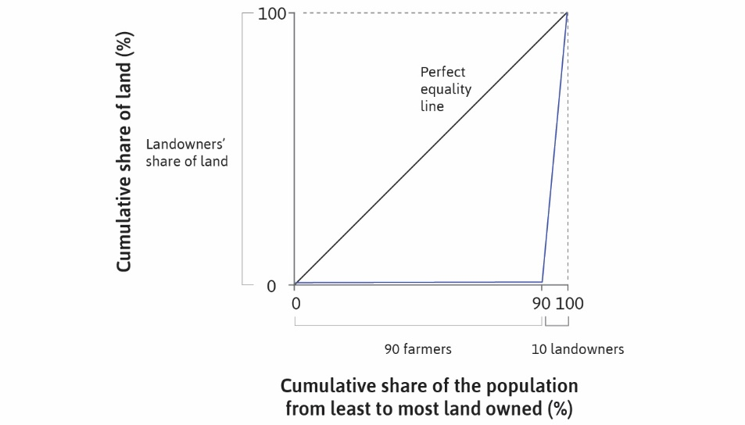

Slide 16
Example
Consider a group of eight persons
Incomes as shown on next slide
Range between $10 and $500
Sum of incomes is $1,000
To compute Lorenz curve, first sort data
Then compute cumulative population and cumulative income shares
Then plot along with line of perfect equality

Slide 17
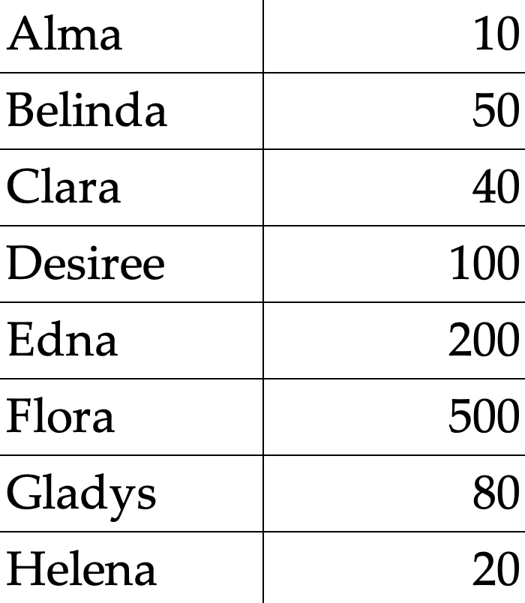

Slide 18
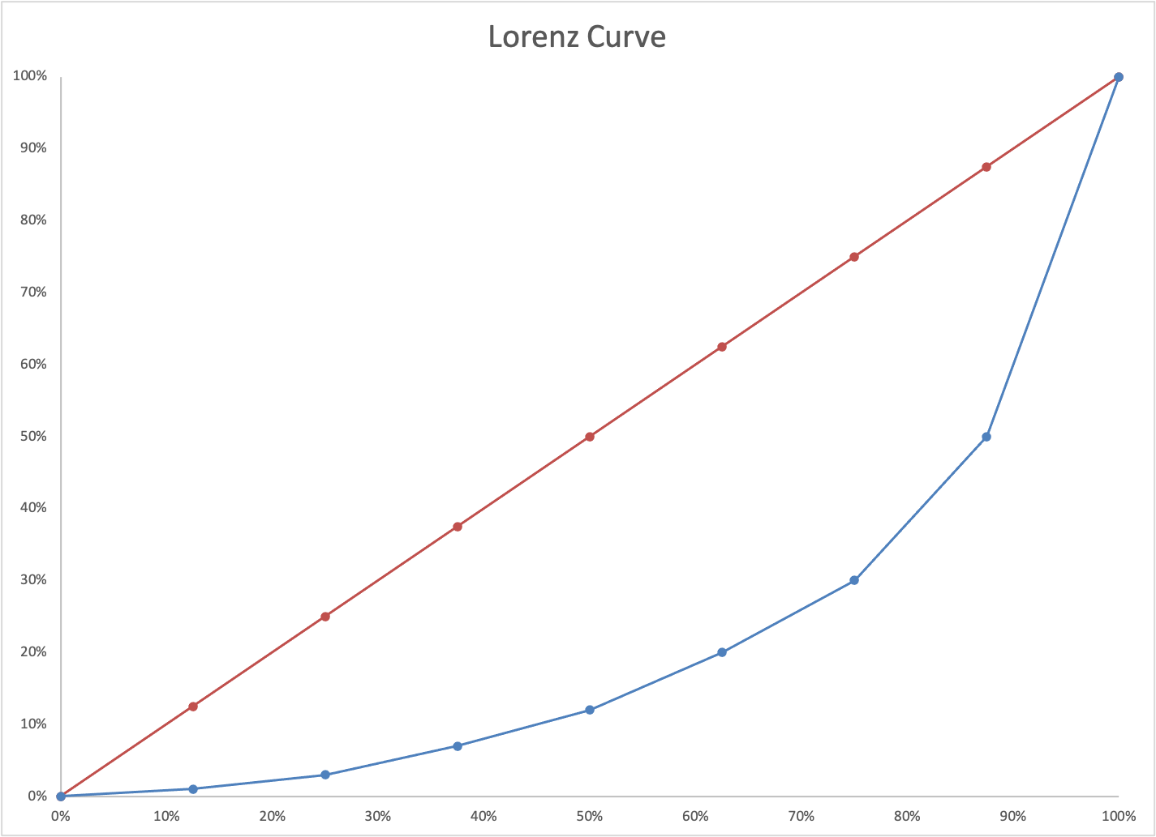

Slide 19
Lorenz Curves and General Principles
If two income distributions can be ranked using Lorenz Curves
Then they can be ranked using the three principles
And these two rankings will be identical
But Lorenz Curves can’t rank all distributions
So they provide an incomplete ordering
How can this be completed?

Slide 20
Gini Coefficient
If one Lorenz curve lies below another we can compare levels of inequality
But what if the curves cross?
Then the two distributions can’t be unambiguously ranked
Gini coefficient provides a scalar measure of inequality
This allows comparison between any pair of distributions
Let A denote area between Lorenz curve and equality line
Let B denote area below Lorenz curve
Gini (area measure) is ratio of A to A + B

Slide 21
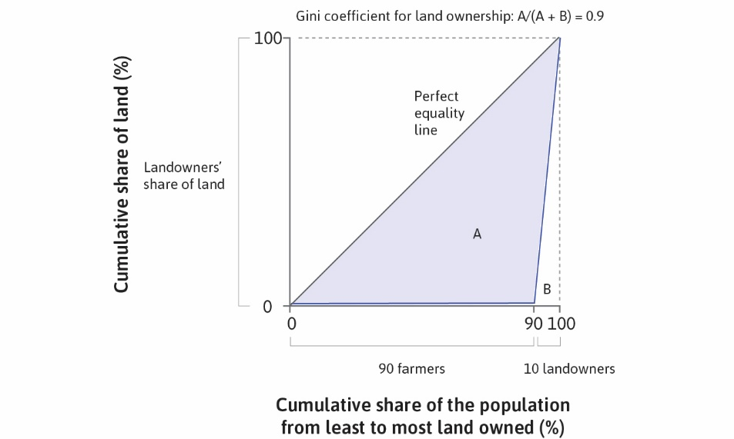

Slide 22
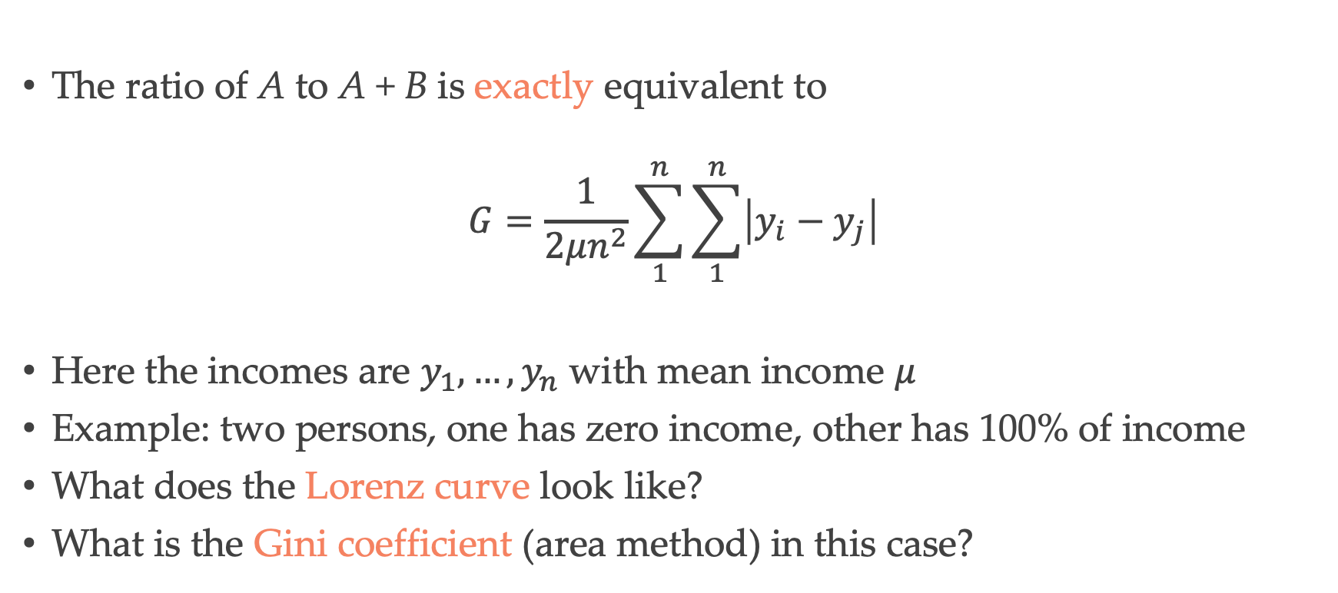
Gini Coefficient
The ratio of A to A + B is exactly equivalent to
$$G=\frac{1}{2μn^{2}}\sum_{1}^{n}{\sum_{1}^{n}{\left|y_{i}−y_{j}\right|}}$$
Here the incomes are $y_{1},…,y_{n}$ with mean income $μ$
Example: two persons, one has zero income, other has 100% of income
What does the Lorenz curve look like?
What is the Gini coefficient (area method) in this case?

Slide 23


Slide 24
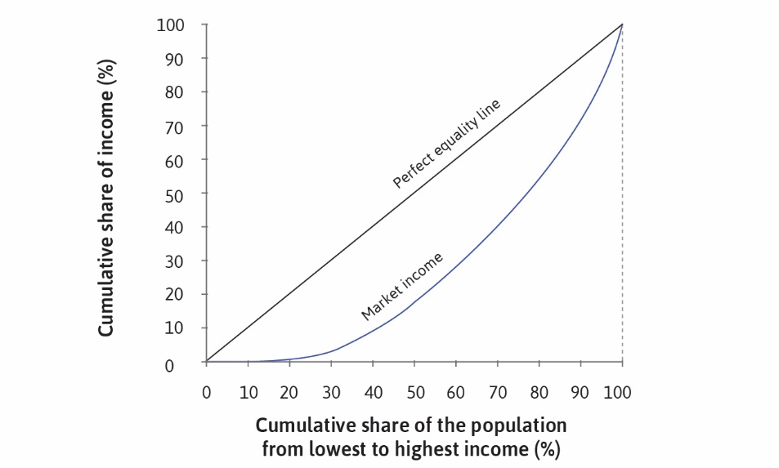

Slide 25
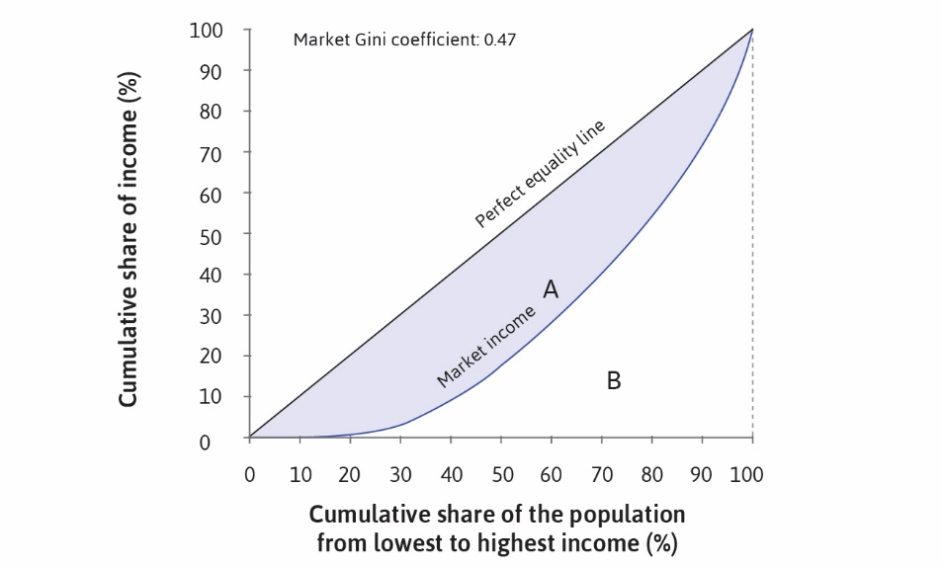

Slide 26
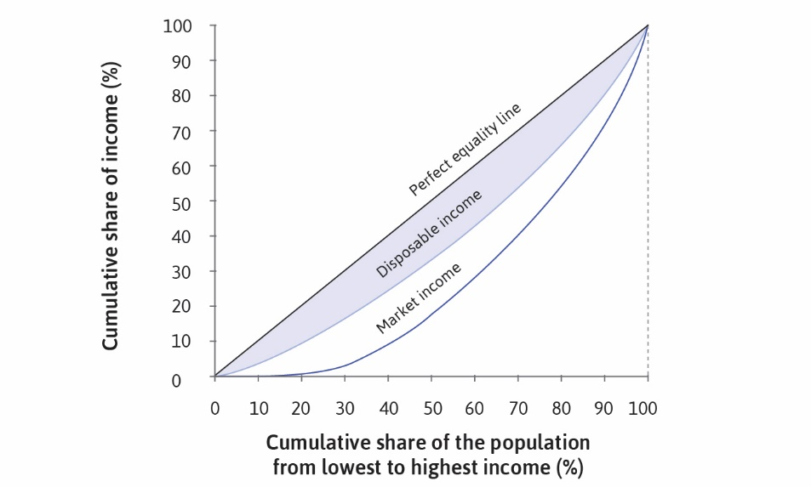

Slide 27
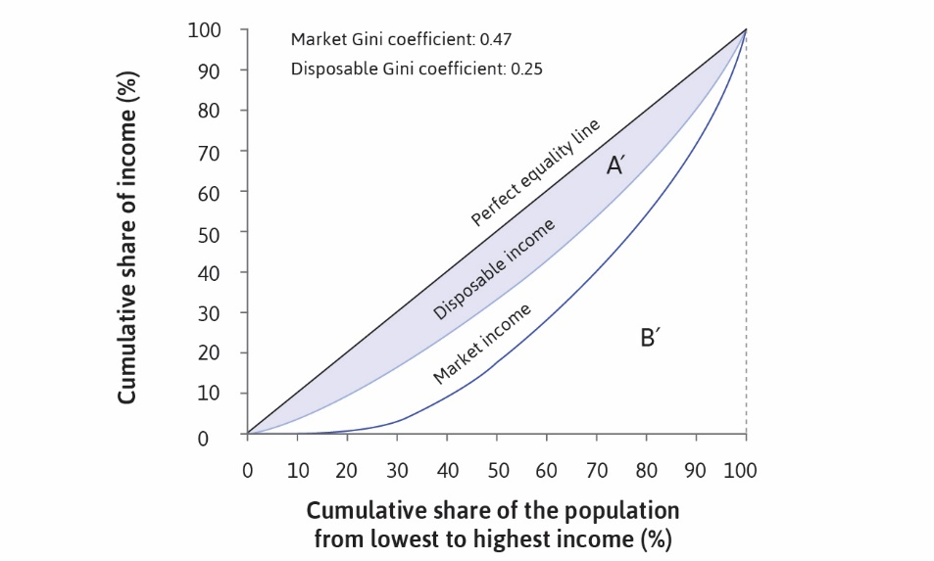

Slide 28
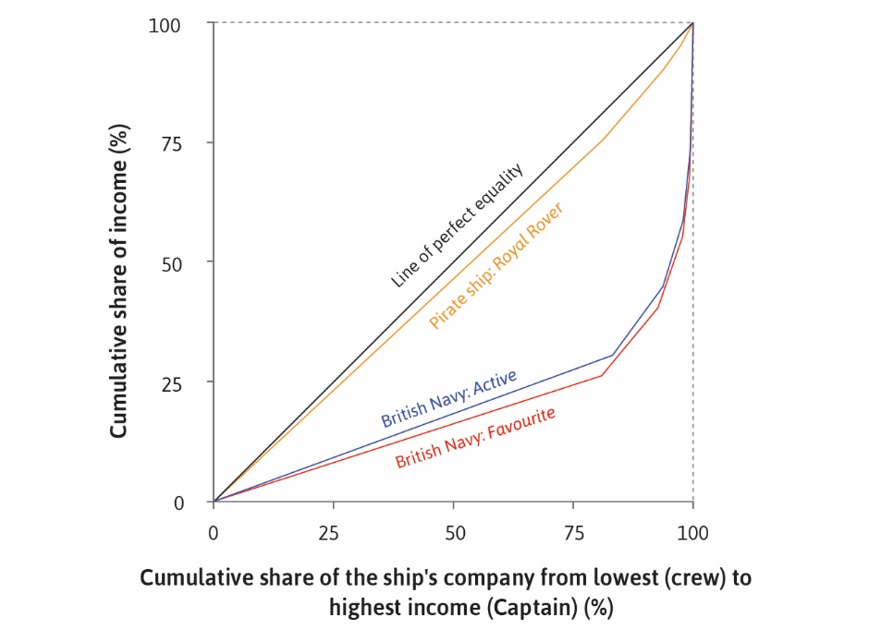

Slide 29
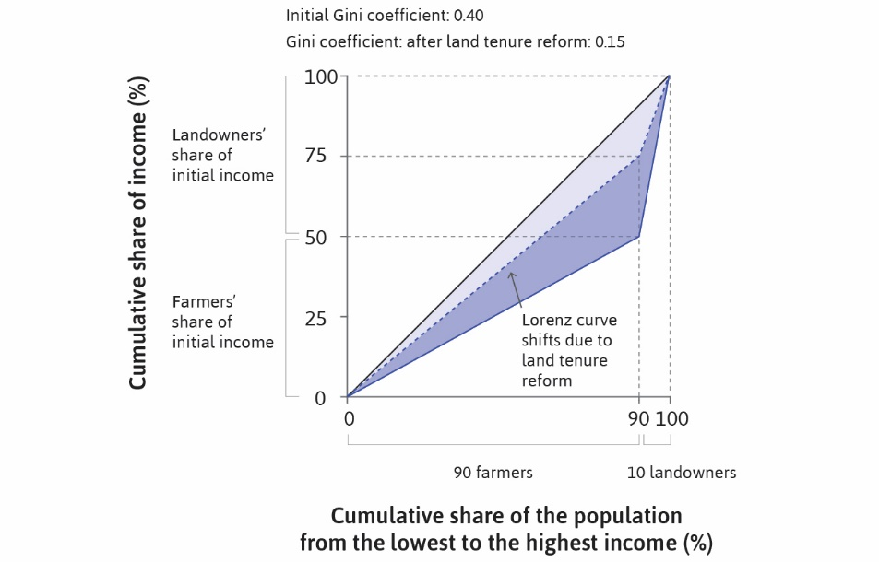

Slide 30
